Slide 1
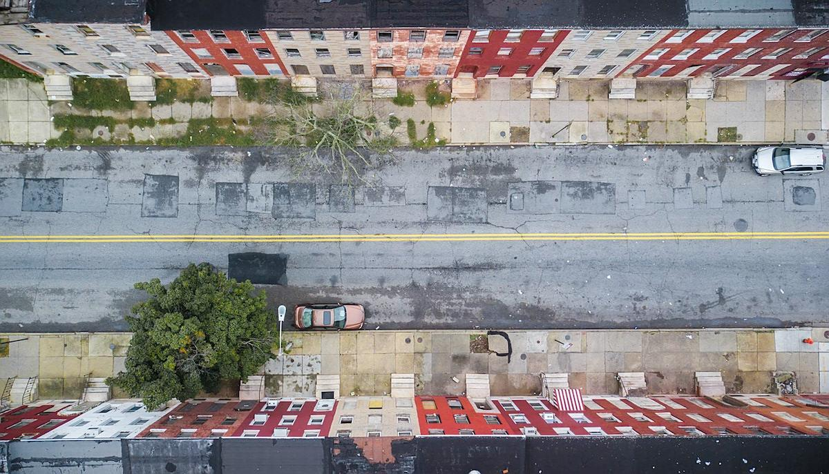
Impervious Surfaces
Environmental and Racial Dimensions
COtools— Anastasia Dai, Hyo In Park
Notes:
Good evening. Today we f

Slide 2
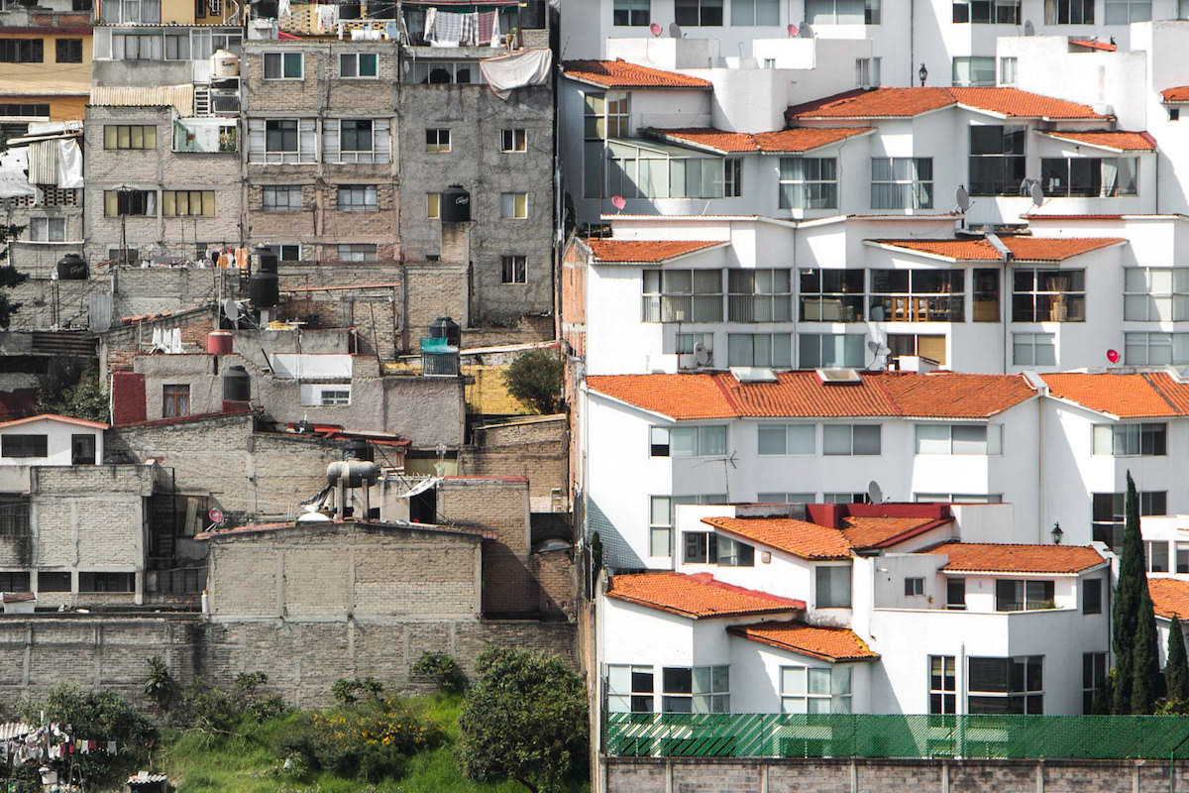
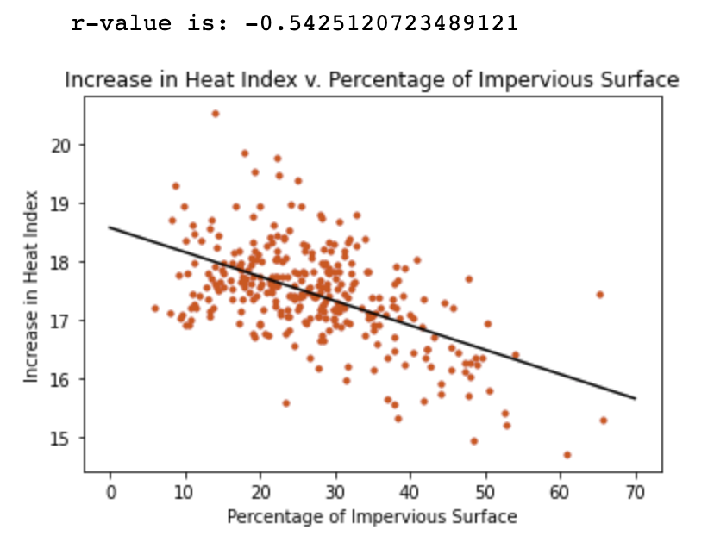
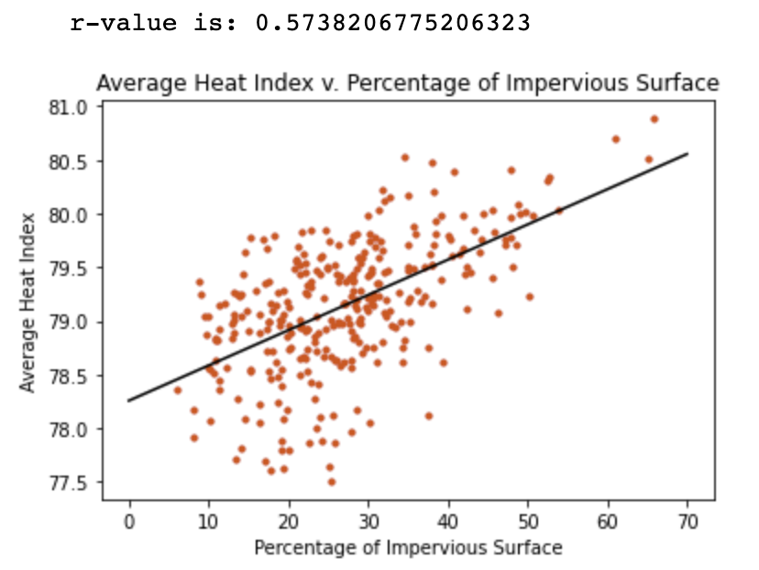
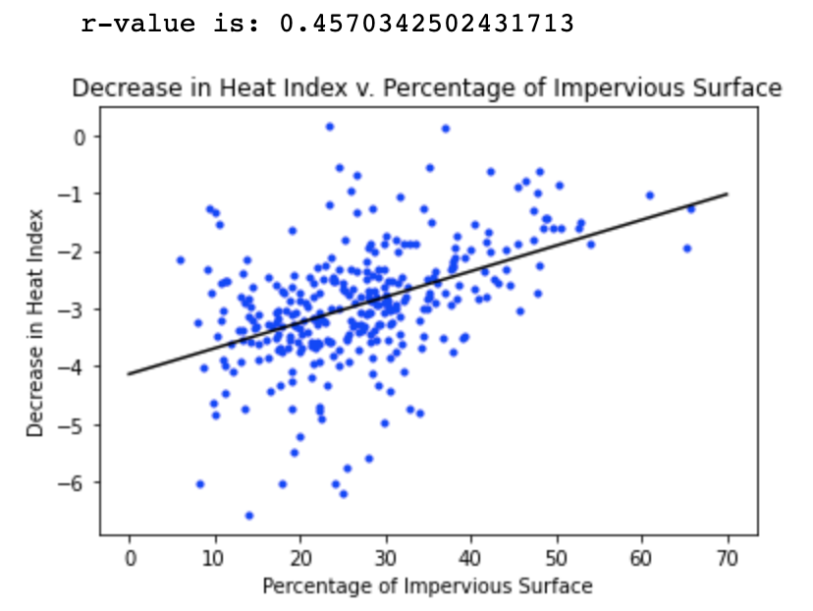
Data set used: Raleigh Durham Aggregated by Block Groups data

Slide 3
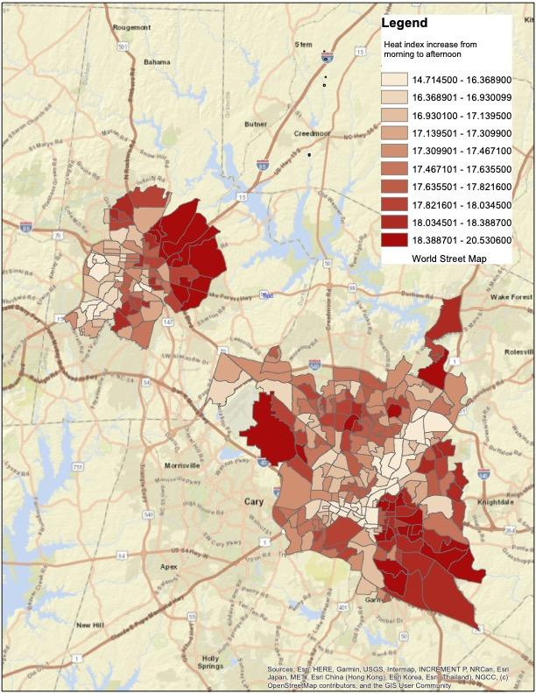
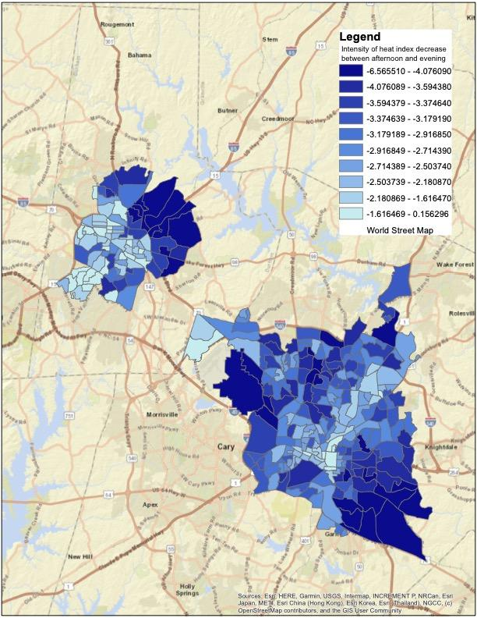
AM_AF_HI
EVE_AF_HI
Notes:
These are maps that compare the heat index levels of raleigh and durham at different times of day. The darker the color is, the more intense the difference between the heat index at different times is. In discussing our possible solutions to urban heat islands, I’d like to focus on

Slide 4
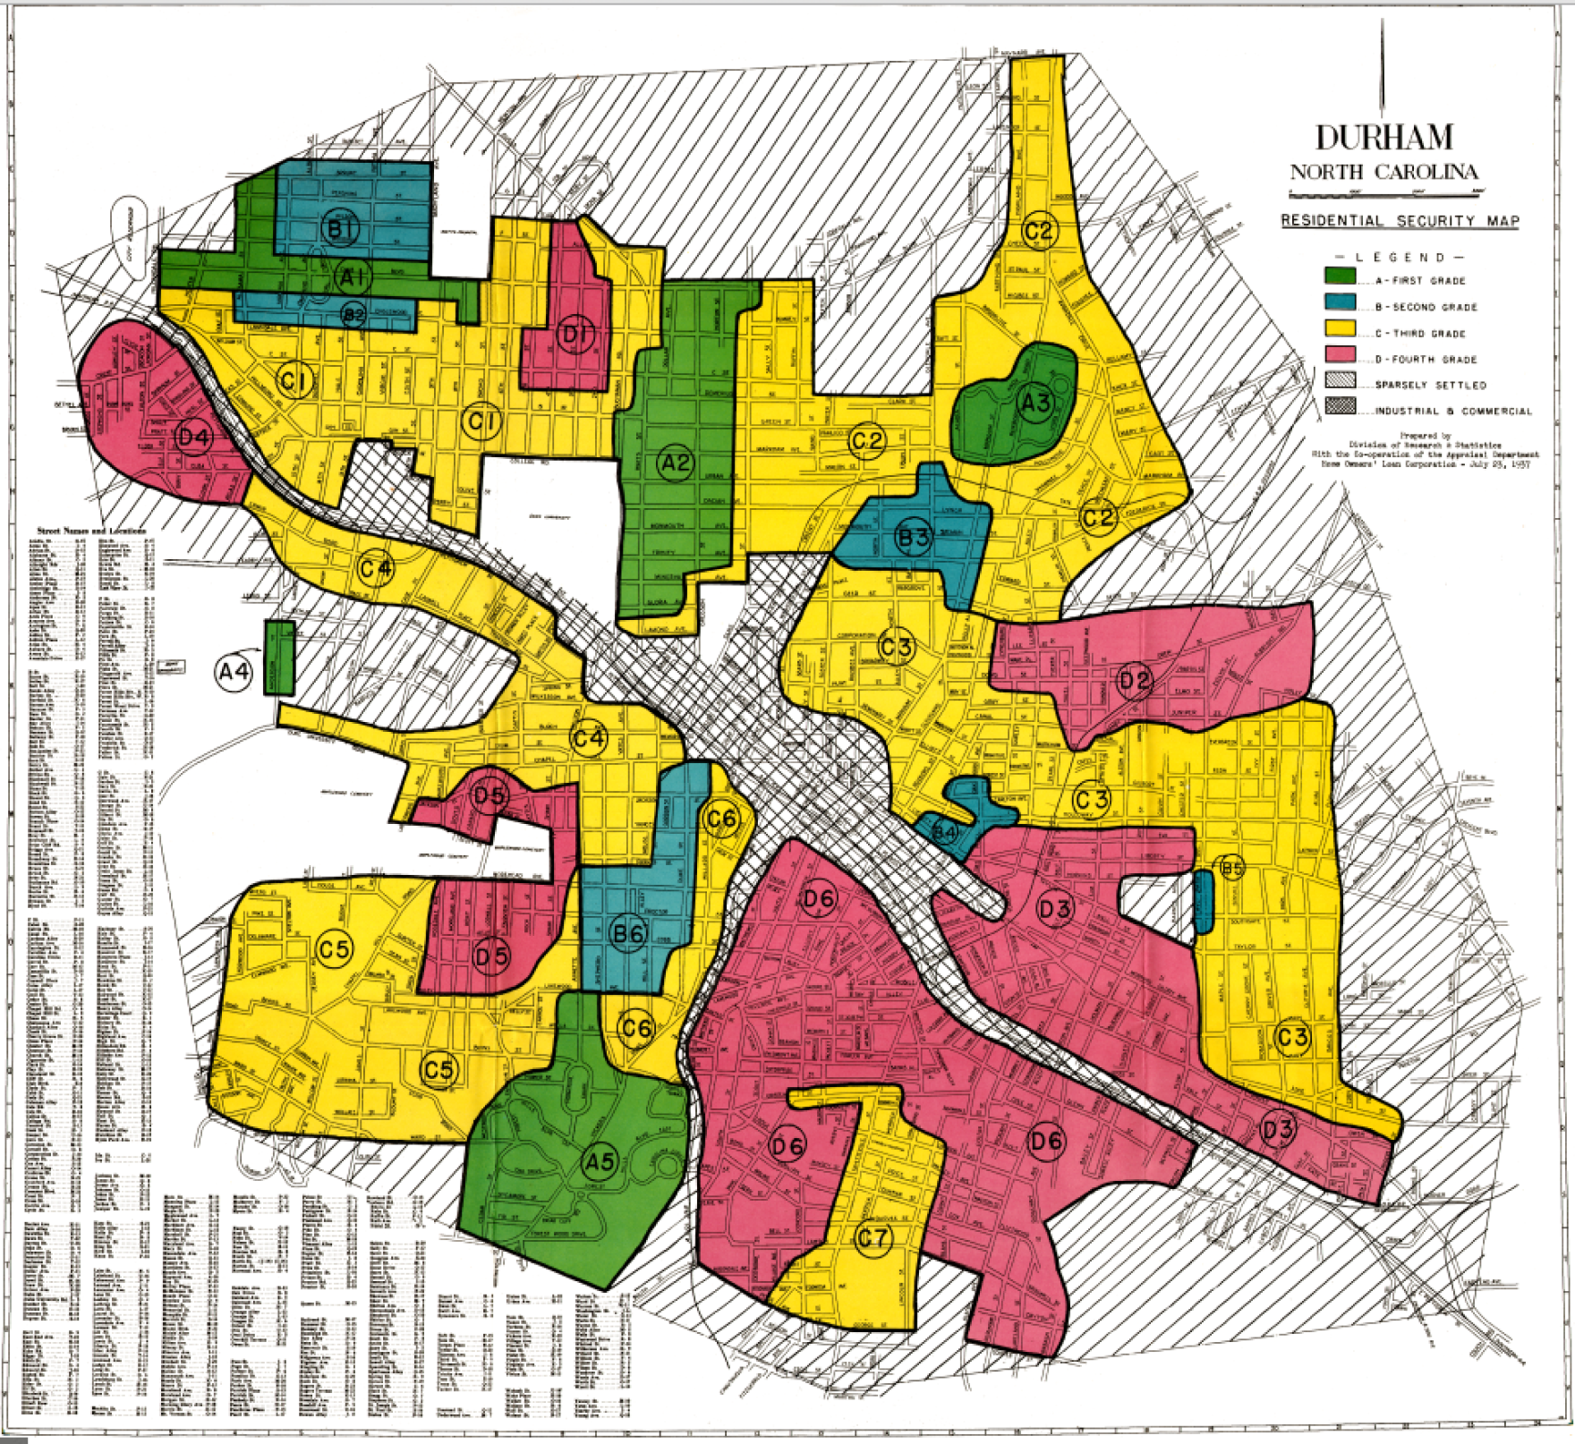
Durham Heat Index Map between morning and afternoon

Slide 5
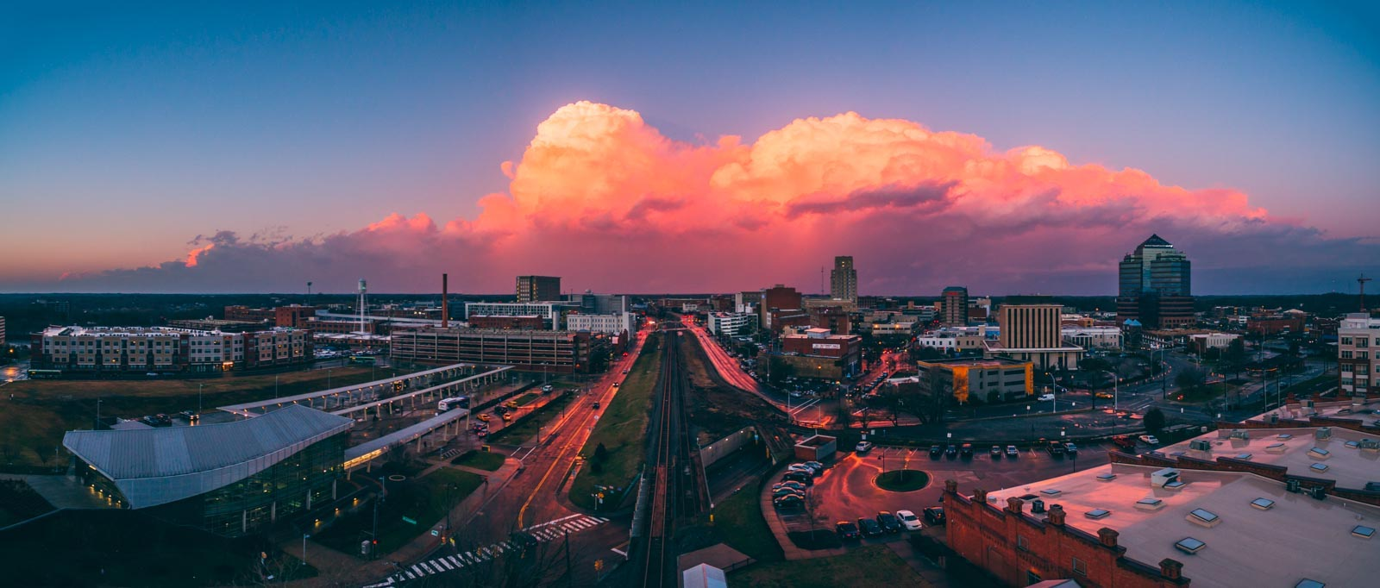
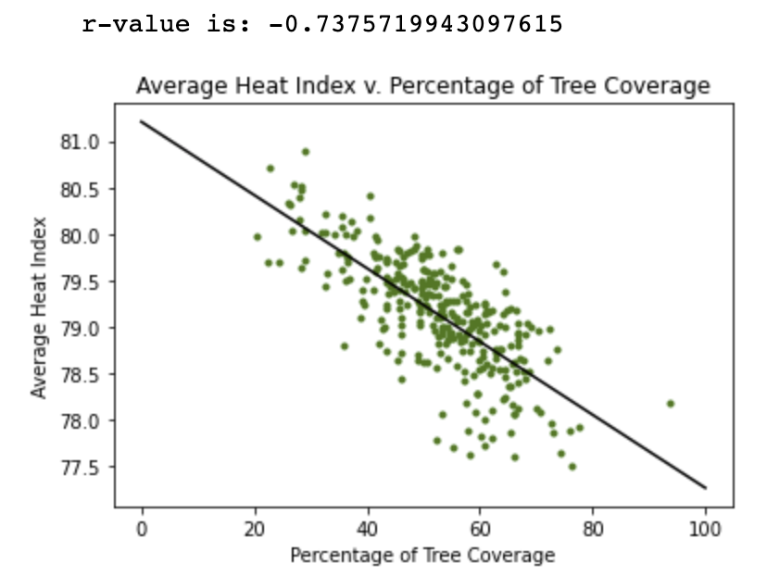
Solutions
More research
Street vegetation
Green roofs
Solar reflective pavement

Slide 6
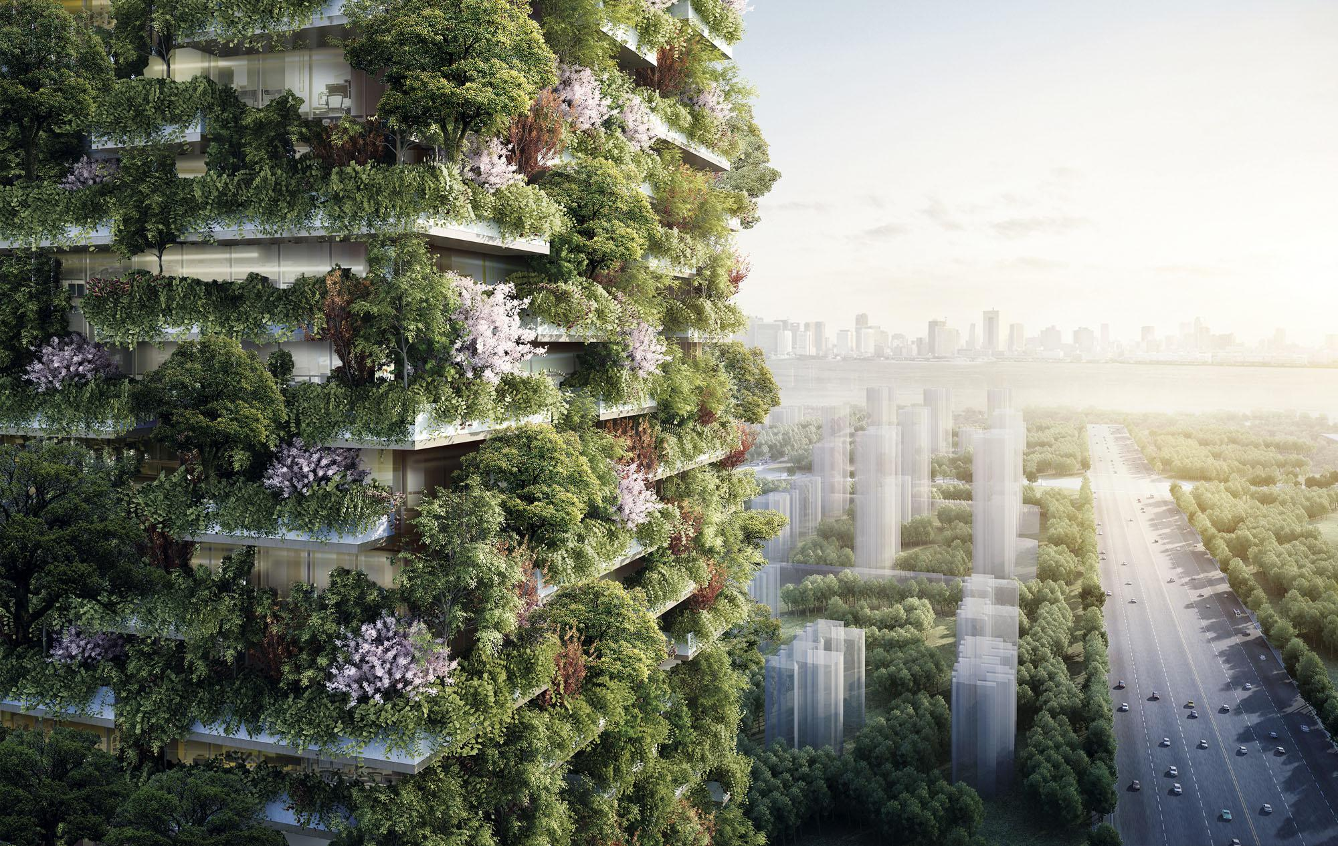
Questions?

